Slide 1
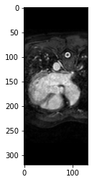
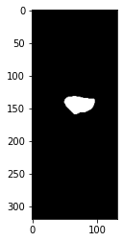
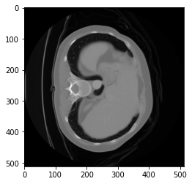
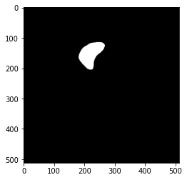
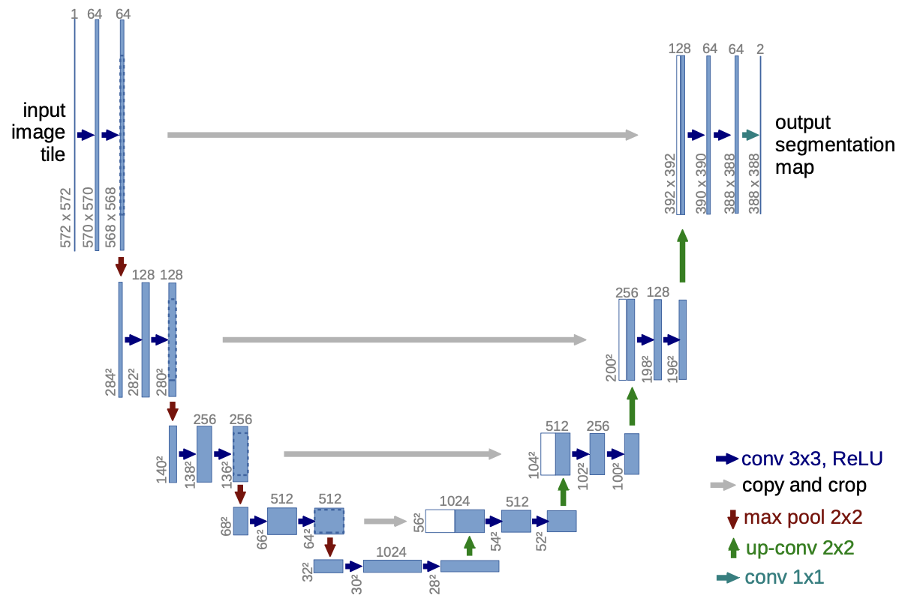
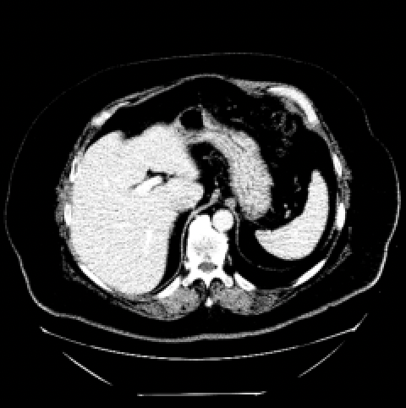
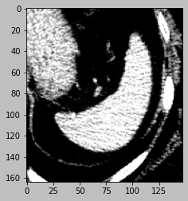
MRI (3D/4D)
ROI
2D/3D U-Net
Hyperparameter Tuning for each task (organ/tissue)
Input Patch Size
U-Net Decoder
Optimizer, Epoch, Batch Size, etc.
CT (3D)
ROI
Resampling
Voxel spacing = (1,1,1) mm
Rescaling Interpolation: Nearest Neighbors
Resizing
Augmentation
Flipping
Rotating
Random cropping
Gaussian Noise
Preprocessed Image Patches
N4 Bias Correction
Skull Stripping (if Brain)
Intensity Normalization
CT windowing
(different organ/tissue)
Evaluation Metrics (Loss Functions)
Dice Coefficient (DSC)
Hausdorff Distance (HD)
Predicted Segmentation Map
How Similar?
Ground-truth ROI

Slide 2
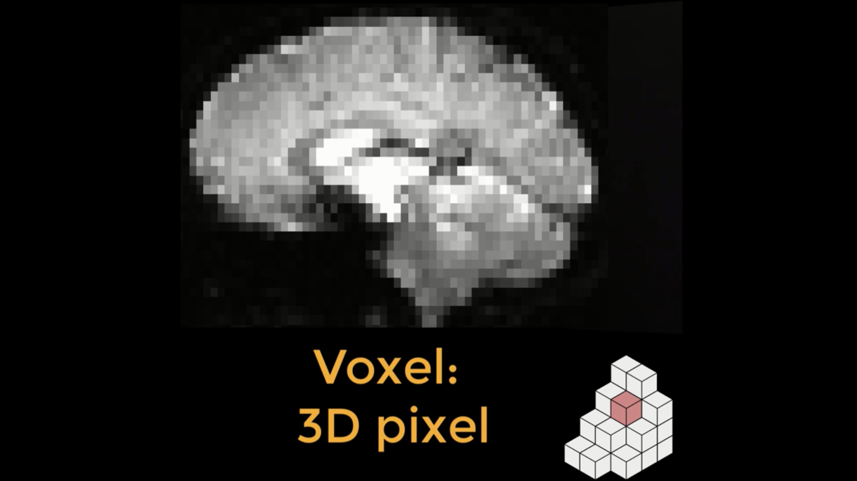
Resampling
Resampling means changing either the resolution, dimensions, or both the resolution and dimensions of an image. A typical fMRI image is composed of voxels, which are like the pixels that make up your computer screen, but in three dimensions. For example, a common voxel size is 3 by 3 by 4 millimeters.
1mm x 1mm x 1mm
In the animation above, we superimpose a 3x3 grid on the original 4x4 grid and then find which number is closest to the center of the new square.
https://andysbrainbook.readthedocs.io/en/latest/FrequentlyAskedQuestions/FrequentlyAskedQuestions.html

Slide 3
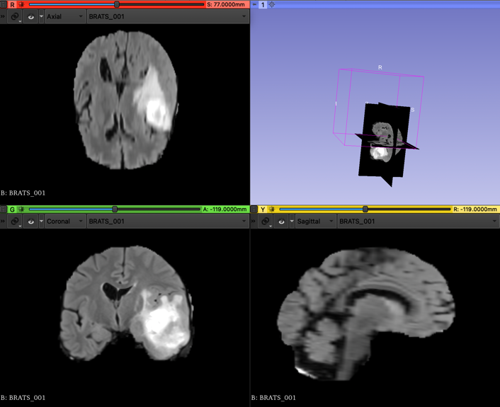

Bias Correction
Bias field signal is a low-frequency and very smooth signal that corrupts MRI images specially those produced by old MRI (Magnetic Resonance Imaging) machines. Image processing algorithms such as segmentation, texture analysis or classification that use the gray-level values of image pixels will not produce satisfactory results.
https://link.springer.com/chapter/10.1007/3-540-32390-2_64

Slide 4
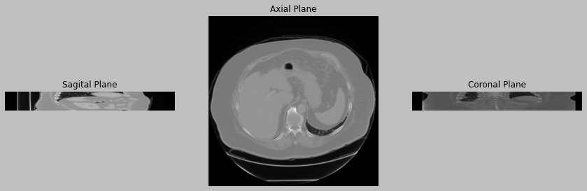
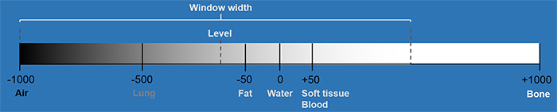
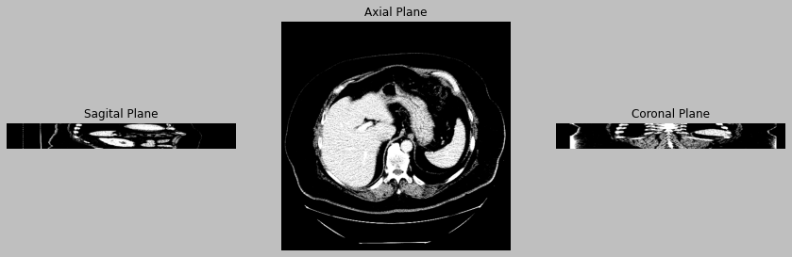
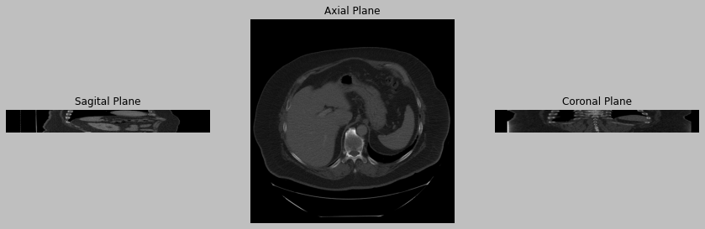
CT Windowing
Original
Windowing

Slide 5
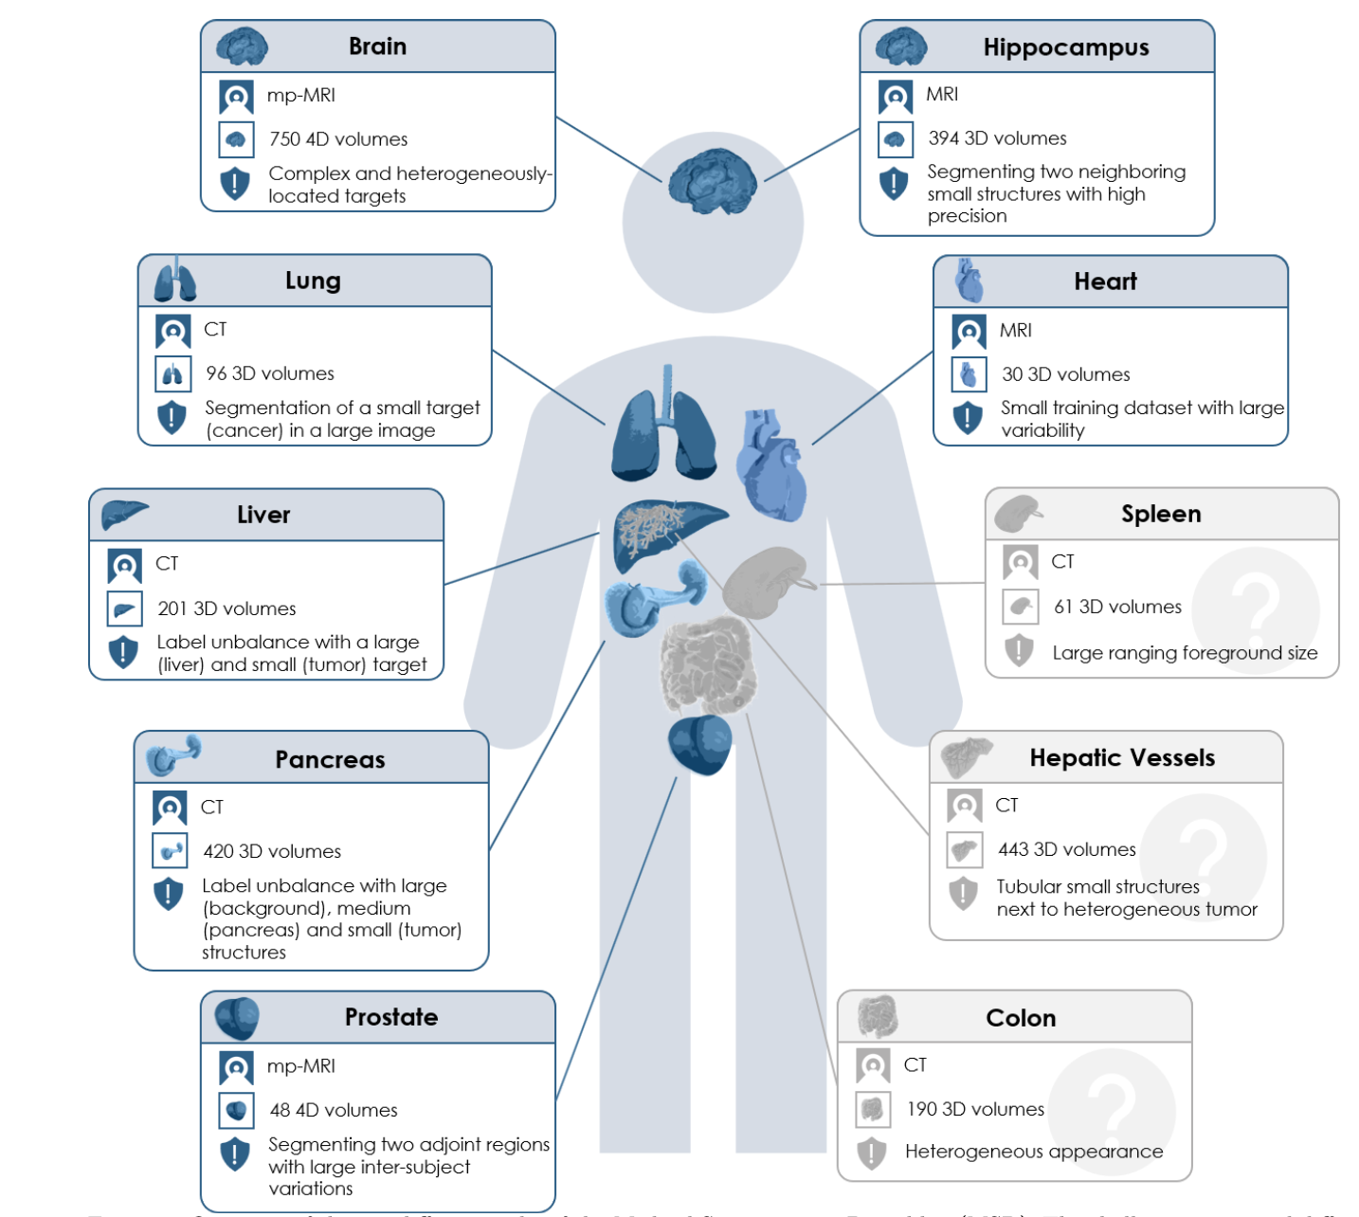

Slide 6
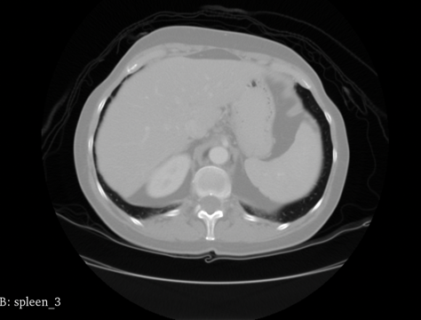
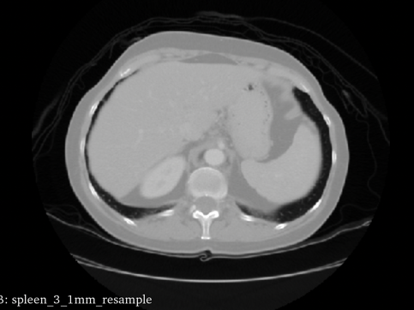
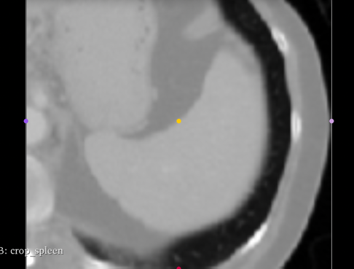
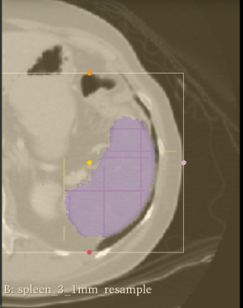
Original
Resampling
Cropping
ROI Labeling

Slide 7
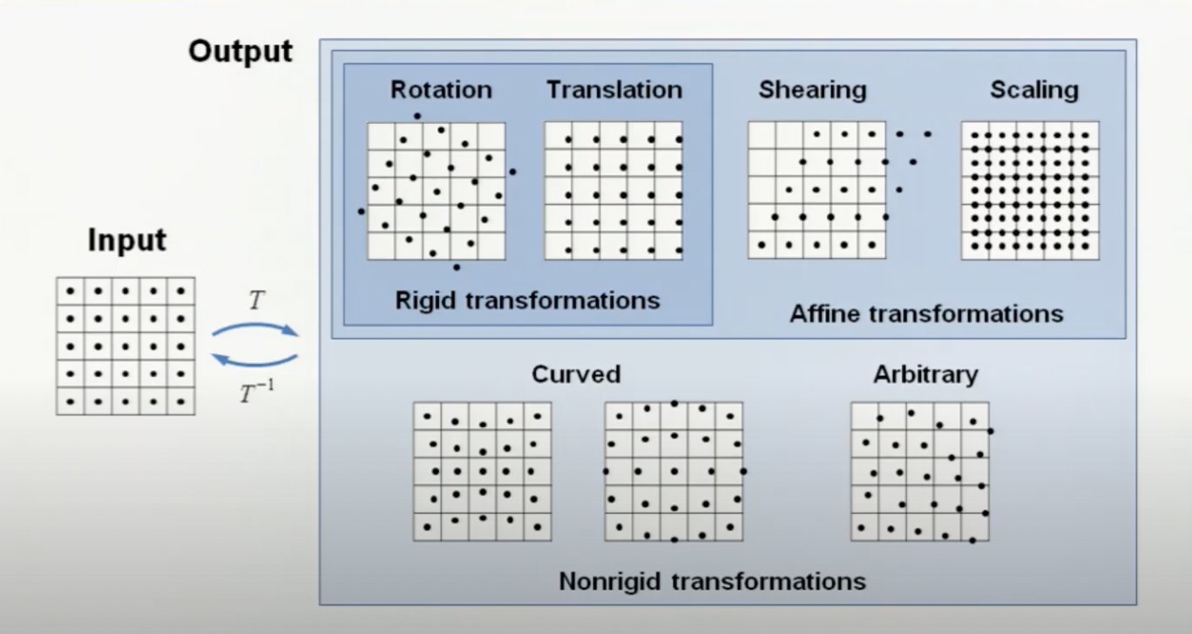
Registration

Slide 8
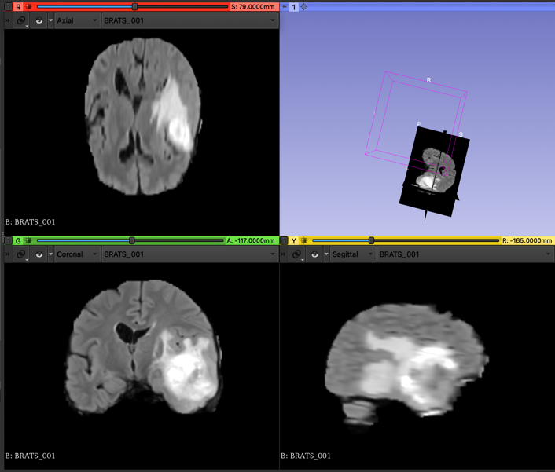
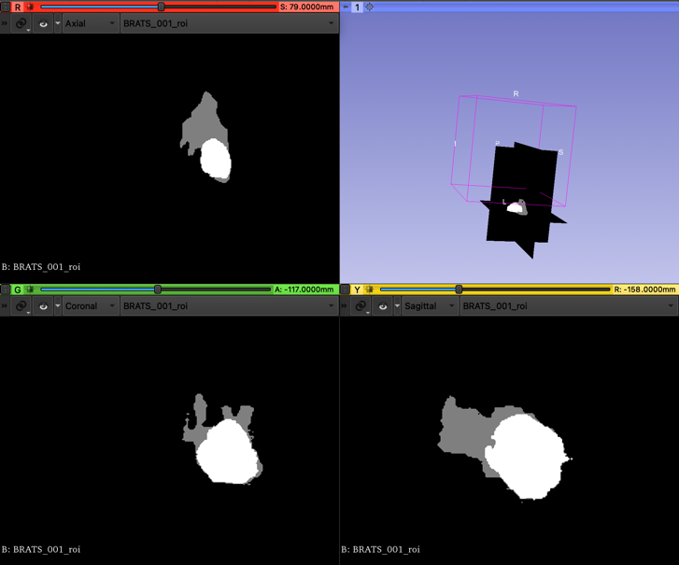
Rigid Rotation

